Slide 1




Music Generation
組員:余丞皓 Peter
楊鈞佑 Jason
余欣達 David
Notes:
1

Slide 2


Music Dataset
Free Midi
Transfer mp3 to mid
https://freemidi.org/
https://www.bearaudiotool.com/mp3-to-midi

Slide 3
Modal
Layer (type) Output Shape Param #
=============================================================
lstm_1 (LSTM) (None, 50, 128) 95232
________________________________________________________________
dropout_1 (Dropout) (None, 50, 128) 0
________________________________________________________________
lstm_2 (LSTM) (None, 128) 131584
________________________________________________________________
dropout_2 (Dropout) (None, 128) 0
________________________________________________________________
dense_1 (Dense) (None, 57) 7353
________________________________________________________________
activation_1 (Activation) (None, 57) 0
==============================================================

Slide 4
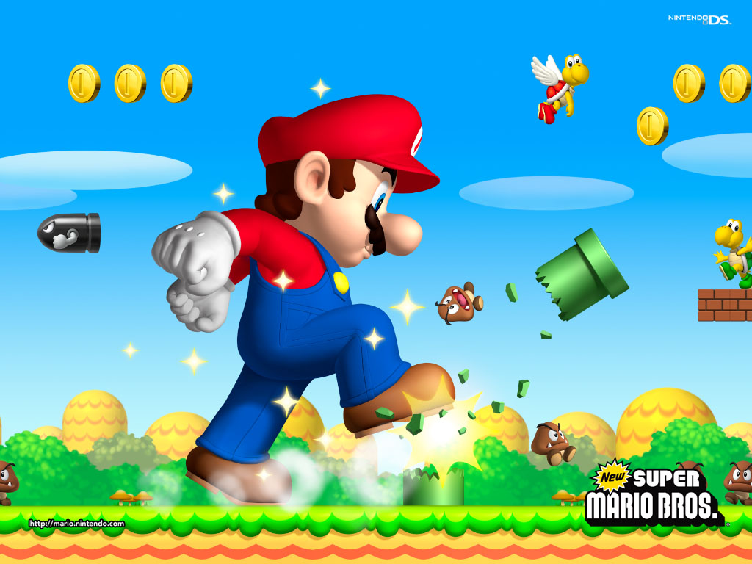
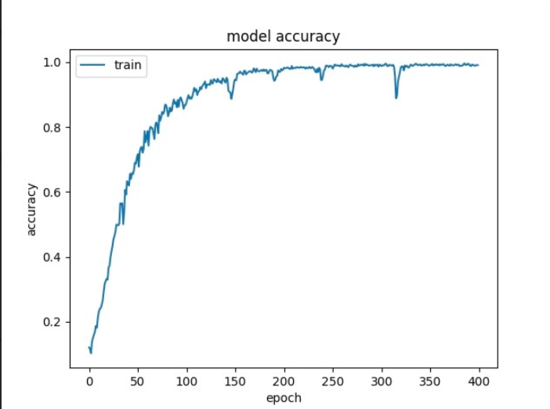

Mario Overworld / Main Theme
Notes:
© Copyright Showeet.com – Free PowerPoint Templates
4

Slide 5

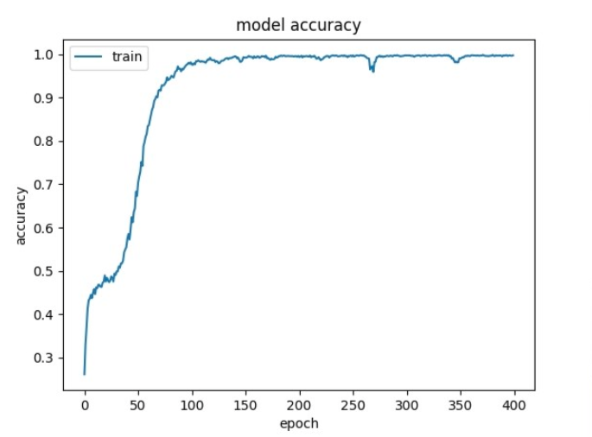
The Scientist Coldplay
Notes:
© Copyright Showeet.com – Free PowerPoint Templates
5

Slide 6
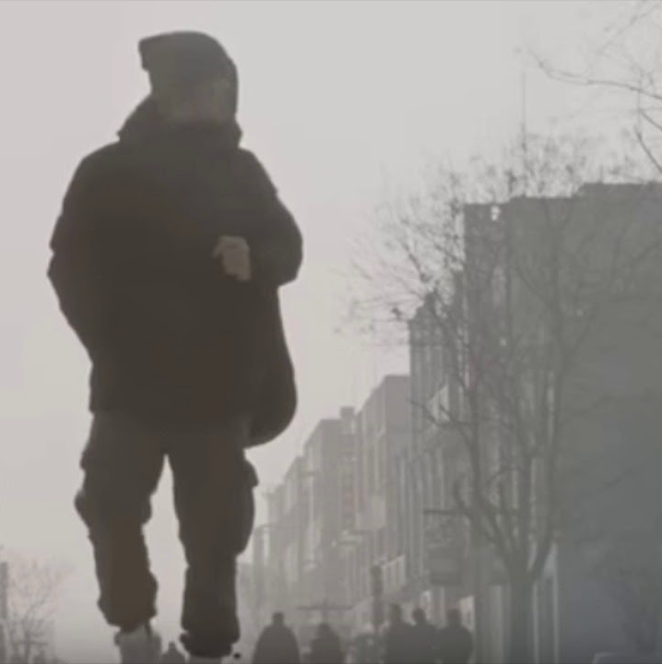
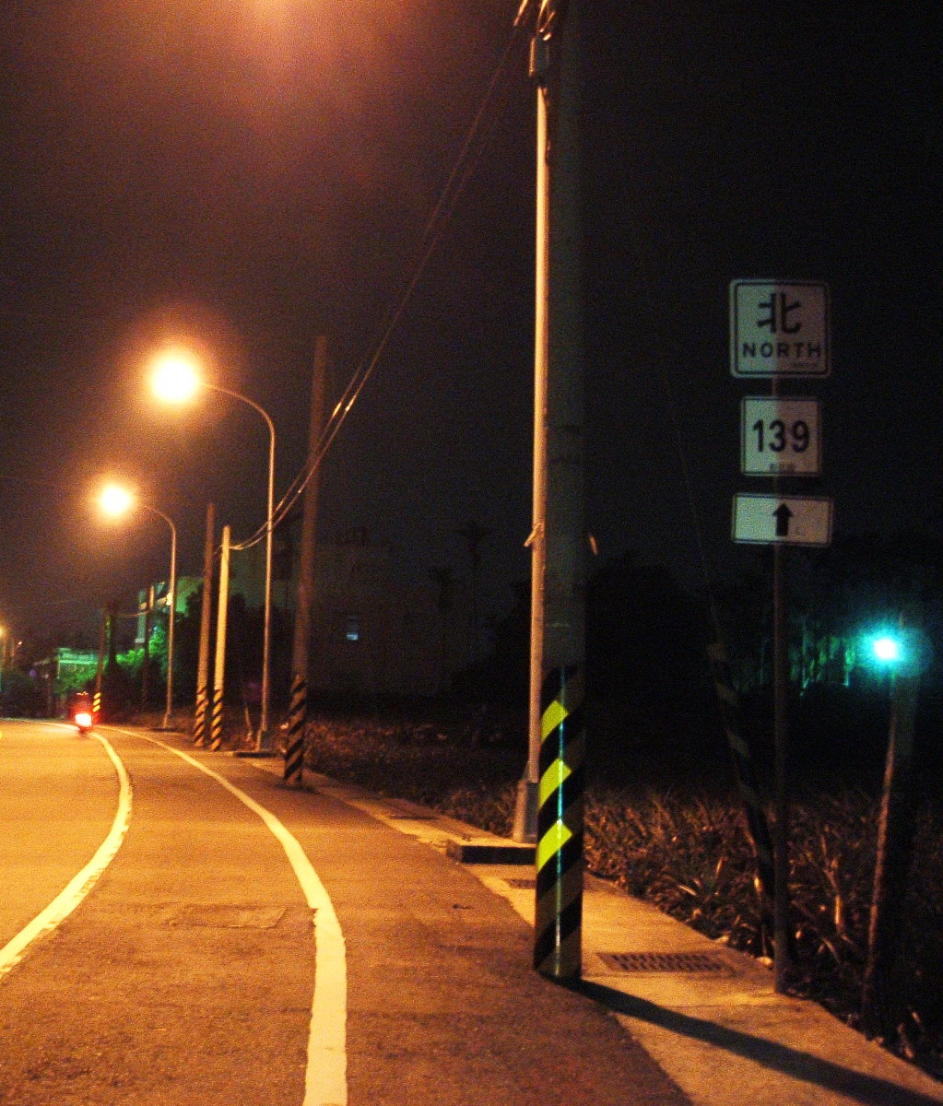


Stranger In The North
A late encounter
Notes:
© Copyright Showeet.com – Free PowerPoint Templates
6

Slide 7

Stranger In The North + A late encounter
Notes:
© Copyright Showeet.com – Free PowerPoint Templates
7

Slide 8
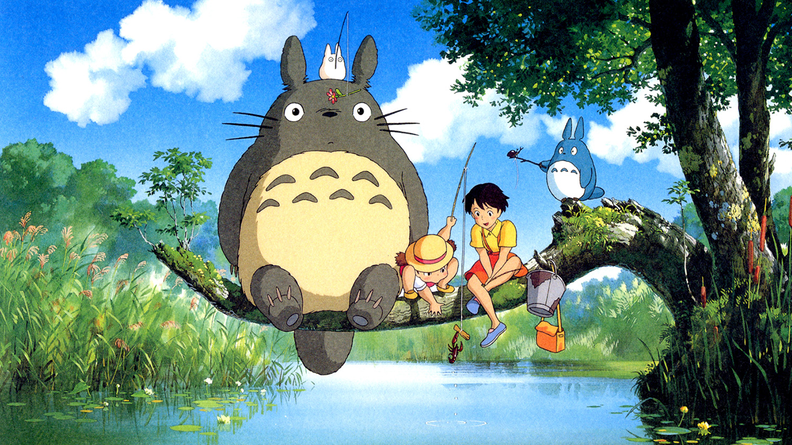
My Neighbor Totoro

Slide 9
Thank You!
Notes:
© Copyright Showeet.com
9

